Slide 1
Security Concepts

Slide 2
Section 1: Network Threats
Upon completion of the section, you should be able to:
Describe the evolution of network security.
Describe the various types of attack tools used by hackers.
Describe malware.
Explain common network attacks.

Slide 3
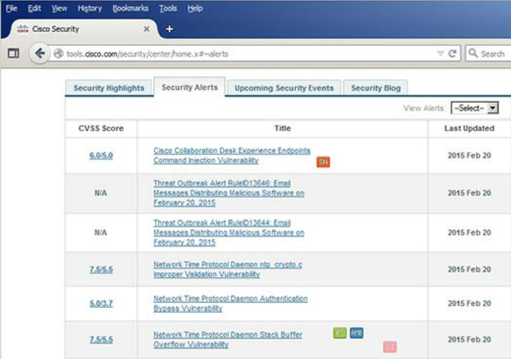
Drivers for Network Security
Common network security terms:
Threat
Vulnerability
Mitigation
Risk
Cisco Security Intelligence Operations
Notes:
1.1.1.2 Drivers for Network Security

Slide 4

The Hacker & The Evolution of Hackers
Modern hacking titles:
Script Kiddies
Vulnerability Brokers
Hacktivists
Cyber Criminals
State-Sponsored Hackers
Notes:
1.2.1.1 The Hacker
1.2.1.2 The Evolution of Hackers
1.2.1.3 Cyber Criminals
1.2.1.4 Hacktivists
1.2.1.5 State-Sponsored Hackers

Slide 5
Evolution of Security Tools
Penetration testing tools:
Password crackers
Wireless hacking
Network scanning and hacking
Packet crafting
Packet sniffers
Rootkit detectors
Fuzzers to search vulnerabilities
Forensic
Debuggers
Hacking operating systems
Encryption
Vulnerability exploitation
Vulnerability Scanners
Notes:
1.2.2.2 Evolution of Security Tools

Slide 6
Categories of Attack Tools
Network hacking attacks:
Eavesdropping
Data modification
IP address spoofing
Password-based
Denial-of-service
Man-in-the-middle
Compromised-key
Sniffer
Notes:
1.2.2.3 Categories of Attack Tools

Slide 7

Viruses
Notes:
1.2.3.2 Viruses

Slide 8
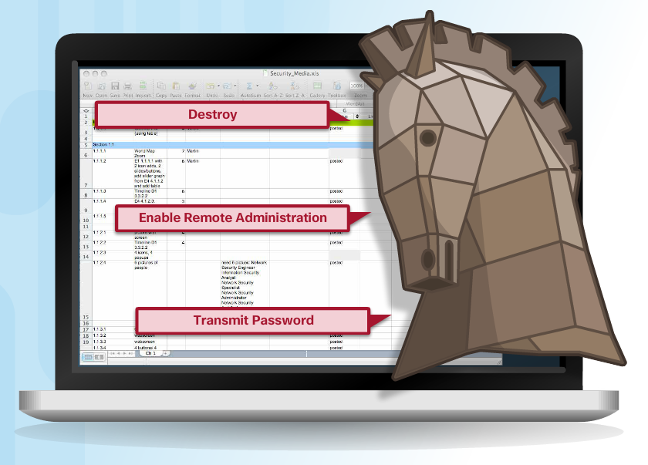
Trojan Horse Classification
Classifications:
Security software disabler
Remote-access
Data-sending
Destructive
Proxy
FTP
DoS
Notes:
1.2.3.3 Trojan Horses
1.2.3.4 Trojan Horse Classification

Slide 9
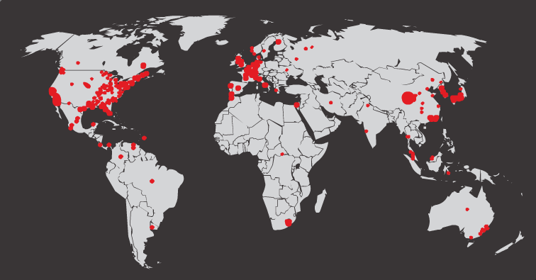
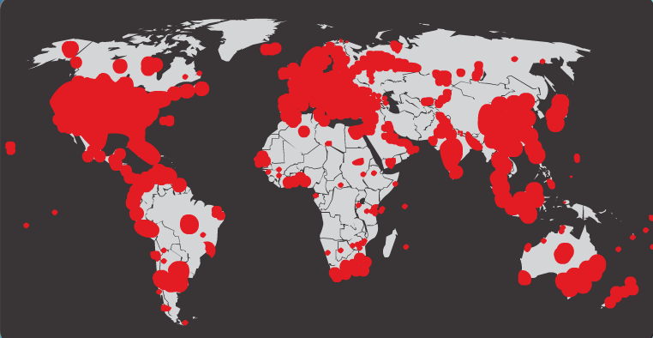
Worms
Initial Code Red Worm Infection
Code Red Worm Infection 19 Hours Later
Notes:
1.2.3.5 Worms

Slide 10
Worm Components
Code Red Worm Propagation
1. Propagate for 19 days
2. Launch DoS attack for next 7 days
3. Stop and go dormant for a few days
4. Repeat the cycle
Components:
Enabling vulnerability
Propagation mechanism
Payload
Notes:
1.2.3.6 Worm Components

Slide 11

Other Malware
Ransomware
Spyware
Adware
Scareware
Phishing
Rootkits
Notes:
1.2.3.7 Other Malware
1.2.3.8 Activity - Identify the Malware Type

Slide 12
Types of Network Attacks
Data Modification
Syn Flood
Smurf Attack
Reconnaissance Access DoS
Notes:
1.1.1.1 Networks Are Targets

Slide 13

Reconnaissance Attacks
Initial query of a target
Ping sweep of the target network
Port scan of active IP addresses
Vulnerability scanners
Exploitation tools
Notes:
1.2.4.2 Reconnaissance Attacks
1.2.4.3 Sample Reconnaissance Attacks

Slide 14
Access Attacks
A few reasons why hackers use access attacks:
To retrieve data
To gain access
To escalate access privileges
A few types of access attacks include:
Password
Trust exploitation
Port redirection
Man-in-the-middle
Buffer overflow
IP, MAC, DHCP spoofing
Notes:
1.2.4.5 Access Attacks
1.2.4.6 Types of Access Attacks

Slide 15
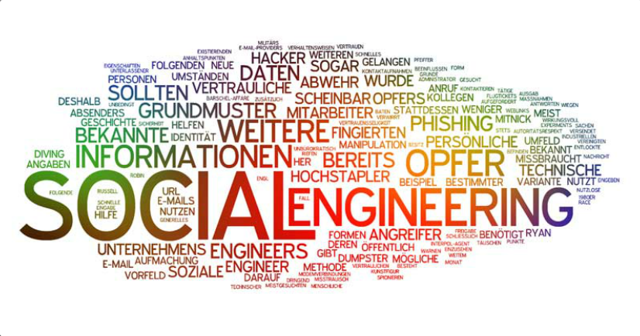
Social Engineering Attacks
Pretexting
Phishing
Spearphishing
Spam
Tailgating
Something for Something
Baiting
Notes:
1.2.4.6 Social Engineering

Slide 16
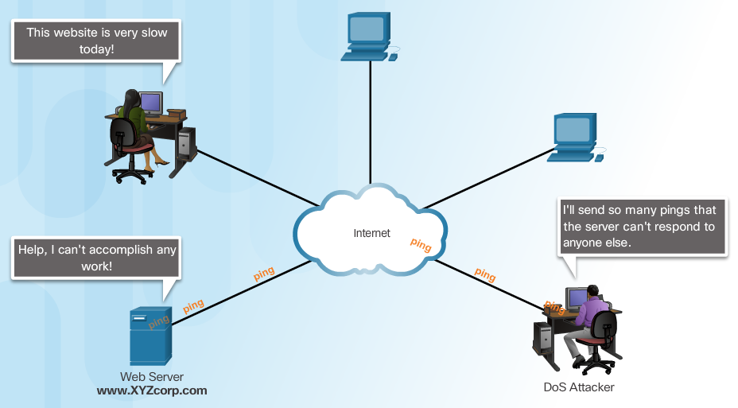
Denial of Service Attacks
Notes:
1.2.4.7 Denial of Service Attacks
1.2.4.8 Types of DoS Attacks

Slide 17
DDoS Attacks
Hacker builds a network of infected machines
A network of infected hosts is called a botnet.
The compromised computers are called zombies.
Zombies are controlled by handler systems.
Zombie computers continue to scan and infect more targets
Hacker instructs handler system to make the botnet of zombies carry out the DDoS attack
Notes:
1.2.4.9 DDoS Attacks
1.2.4.10 DDoS Attacks (cont.) - Video https://www.youtube.com/watch?v=NogCN78XN2w
1.2.4.11 Activity - Identify the Types of Attack
1.2.4.12 Lab - Social Engineering

Slide 18
Section 2: Mitigating Threats
Upon completion of this section, you should be able to:
Describe methods and resources to protect the networks.
Describe a collection of domains for network security.
Explain the purpose of the Cisco SecureX Architecture.
Describe the techniques used to mitigate common network attacks.
Explain how to secure the three functional areas of Cisco routers and switches.

Slide 19
Confidentiality, Integrity, Availability
Components of Cryptography
Confidentiality: Uses encryption to encrypt and hide data.
Integrity: Uses hashing algorithms to ensure data is unaltered during operation.
Availability: Assures data is accessible. Guaranteed by network hardening mechanisms and backup systems.
Notes:
1.3.1.3 Confidentiality, Integrity, Availability

Slide 20
Network Security Domains
Risk assessment
Security policy
Organization of information security
Asset management
Human resources security
Physical and environmental security
Communications and operations management
Information systems acquisition, development, and maintenance
Access control
Information security incident management
Business continuity management
Compliance
Notes:
1.3.2.1 Network Security Domains

Slide 21
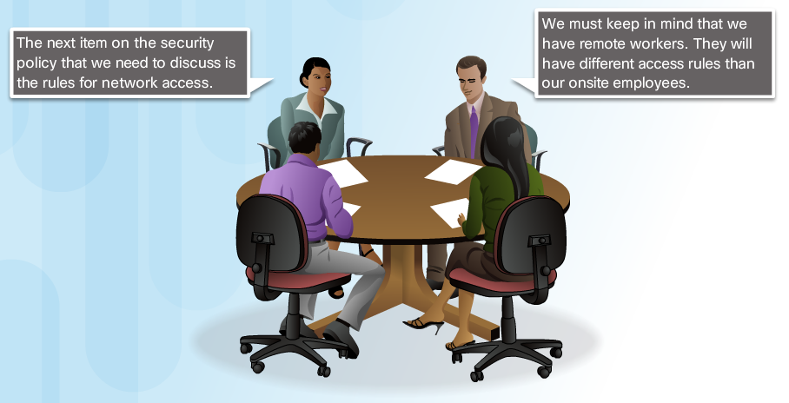
Network Security Policy
Notes:
1.3.2.2 Security Policy
1.3.2.3 Network Security Policy

Slide 22

Network Security Policy Objectives
Notes:
1.3.2.4 Network Security Policy Objectives

Slide 23
Defending the Network
Best practices:
Develop a written security policy.
Educate employees about the risks of social engineering, and develop strategies to validate identities over the phone, via email, or in person.
Control physical access to systems.
Use strong passwords and change them often.
Encrypt and password-protect sensitive data.
Implement security hardware and software.
Perform backups and test the backed up files on a regular basis.
Shut down unnecessary services and ports.
Keep patches up-to-date by installing them weekly or daily to prevent buffer overflow and privilege escalation attacks.
Perform security audits to test the network.
Notes:
1.3.4.1 Defending the Network

Slide 24
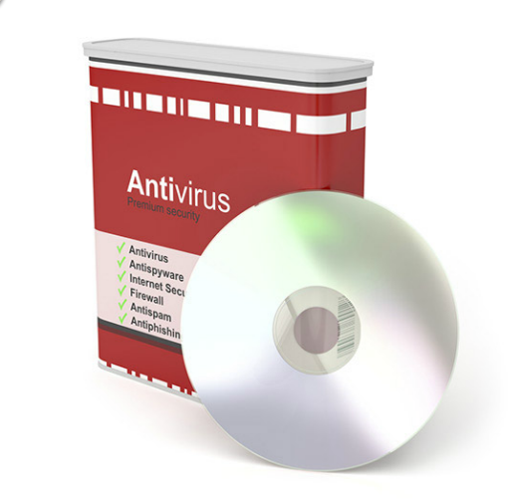
Mitigating Malware
Notes:
1.3.4.2 Mitigating Malware

Slide 25
Mitigating Worms
Containment
Inoculation
Quarantine
Treatment
Notes:
1.3.4.3 Mitigating Worms

Slide 26
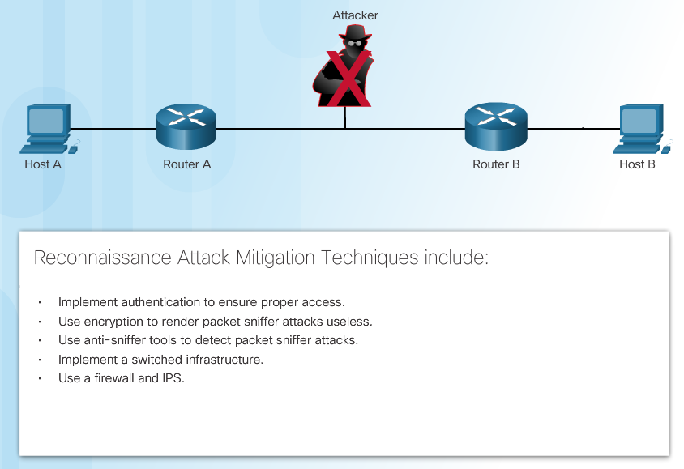
Mitigating Reconnaissance Attacks
Notes:
1.3.4.4 Mitigating Reconnaissance Attacks

Slide 27
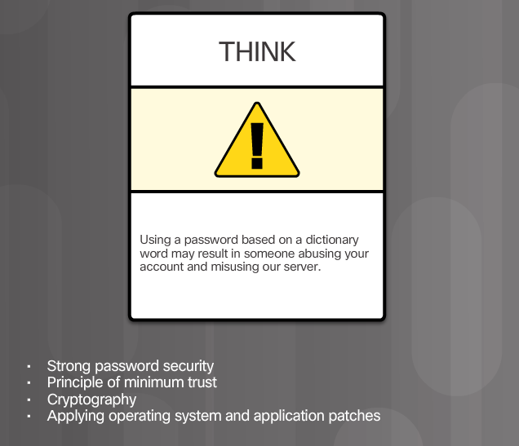
Mitigating Access Attacks
Notes:
1.3.4.5 Mitigating Access Attacks

Slide 28
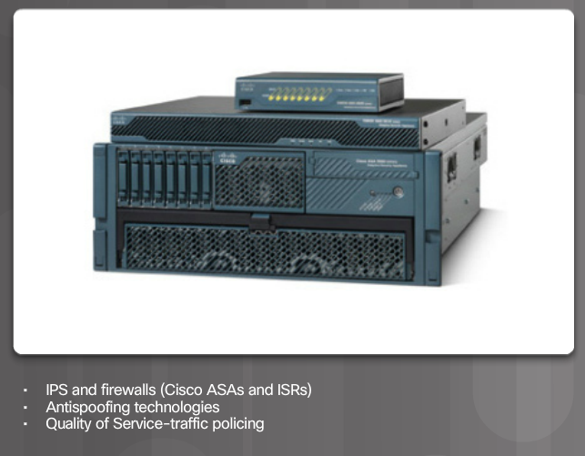
Mitigating DoS Attacks
Notes:
1.3.4.6 Mitigating DoS Attacks

Slide 29
Section 3: Securing Network Devices
Upon completion of this section, you should be able to:
Secure Access in Network Infrastructure
Configure administrative privilege levels to control command availability

Slide 30
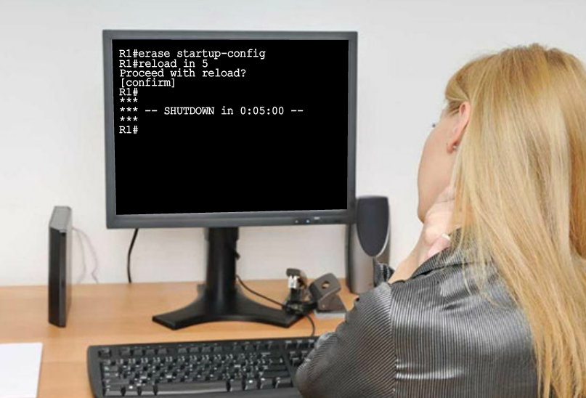
Securing the Network Infrastructure
Notes:
2.1.1.1 Securing the Network Infrastructure

Slide 31
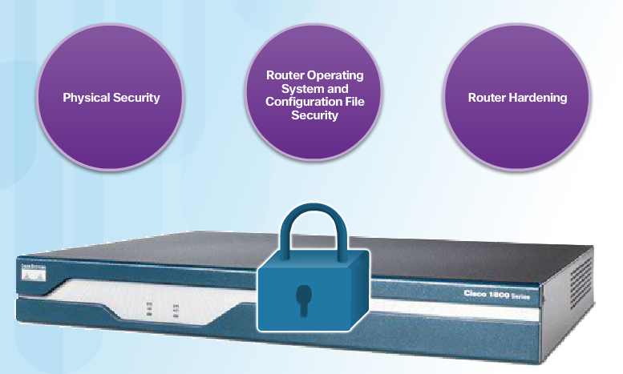
Three Areas of Router Security
Notes:
2.1.1.3 Three Areas of Router Security

Slide 32
Secure Administrative Access
Tasks:
Restrict device accessibility
Log and account for all access
Authenticate access
Authorize actions
Present legal notification
Ensure the confidentiality of data
Notes:
2.1.1.4 Secure Administrative Access

Slide 33
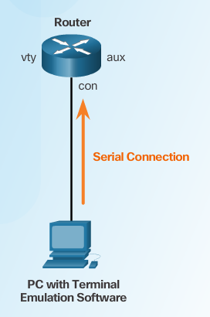
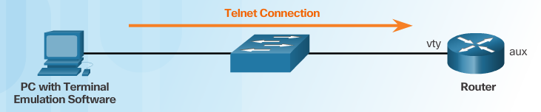
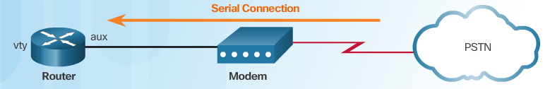
Secure Local and Remote Access
Local Access
Remote Access Using Telnet
Remote Access Using Modem and Aux Port
Notes:
2.1.1.5 Secure Local and Remote Access

Slide 34
Strong Passwords
Guidelines:
Use a password length of 10 or more characters.
Include a mix of uppercase and lowercase letters, numbers, symbols, and spaces.
Avoid passwords based on easily identifiable pieces of information.
Deliberately misspell a password (Smith = Smyth = 5mYth).
Change passwords often.
Do not write passwords down and leave them in obvious places.
Weak Password | Why it is Weak | Strong Password | Why it is Strong
secret | Simple dictionary password | b67n42d39c | Combines alphanumeric characters
smith | Mother’s maiden name | 12^h u4@1p7 | Combines alphanumeric characters, symbols, and includes a space
toyota | Make of car
bob1967 | Name and birthday of user
Blueleaf23 | Simple words and numbers
Notes:
2.1.2.1 Strong Passwords

Slide 35
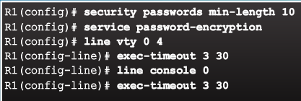
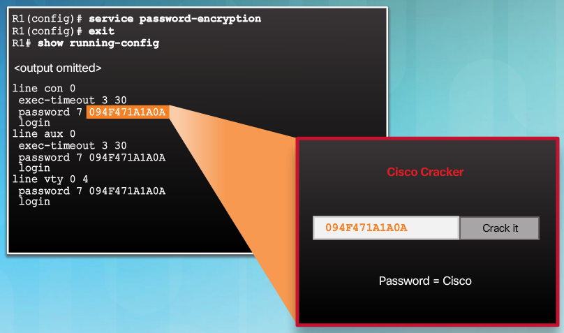
Increasing Access Security
Notes:
2.1.2.2 Increasing Access Security

Slide 36
Secret Password Algorithms
Guidelines:
Configure all secret passwords using type 8 or type 9 passwords
Use the enable algorithm-type command syntax to enter an unencrypted password
Use the username name algorithm-type command to specify type 9 encryption
Notes:
2.1.2.3 Secret Password Algorithms

Slide 37
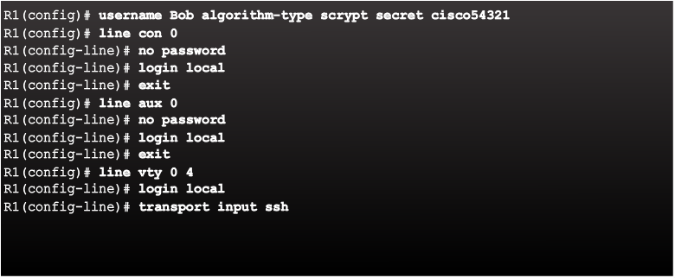
Securing Line Access
Notes:
2.1.2.4 Securing Line Access
Syntax Checker: Secure Administrative Access on R2

Slide 38
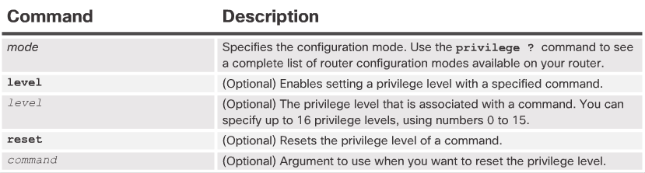
Limiting Command Availability
Privilege levels:
Level 0: Predefined for user-level access privileges.
Level 1: Default level for login with the router prompt.
Level 2-14: May be customized for user-level privileges.
Level 15: Reserved for the enable mode privileges.
Levels of access commands:
User EXEC mode (privilege level 1)
Lowest EXEC mode user privileges
Only user-level command available at the router> prompt
Privileged EXEC mode (privilege level 15)
All enable-level commands at the router# prompt
Privilege Level Syntax
Notes:
2.2.1.1 Limiting Command Availability

Slide 39
Limitations of Privilege Levels
No access control to specific interfaces, ports, logical interfaces, and slots on a router
Commands available at lower privilege levels are always executable at higher privilege levels
Commands specifically set at higher privilege levels are not available for lower privilege users
Assigning a command with multiple keywords allows access to all commands that use those
Notes:
2.2.1.3 Limitations of Privilege Levels
Syntax Checker: Configure Privilege Levels on R2

Slide 40
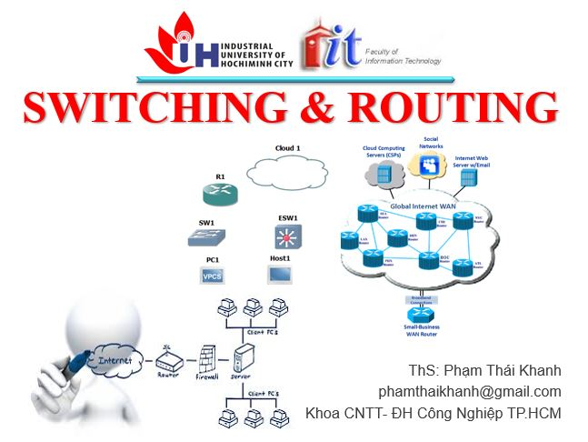

phamthaikhanh@gmail.com
This Photo by Unknown Author is licensed under CC BY-NC

